Slide 1

Parallel Circuits
Electrical Day 2
Notes:
Max & maya

Slide 2
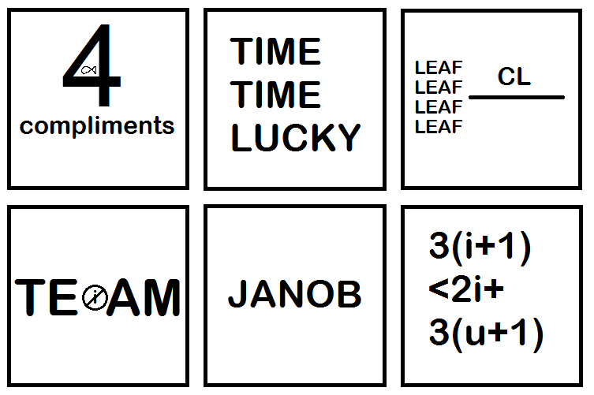
Ice Breaker:
Notes:
maya

Slide 3

Day 2
01
02
03
Parallel Circuits
Build
CAD
10 - What are they? What does it mean?
10 min - Build some Parallel Circuits
30 min - catch up on fuselage CAD
Notes:
mark

Slide 4

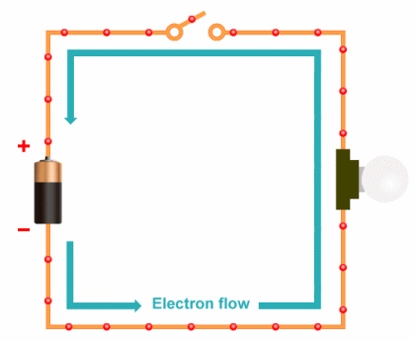
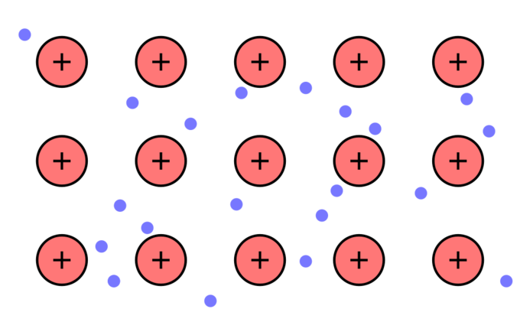
Review:
Electrons in a metal:
Notes:
maya

Slide 5

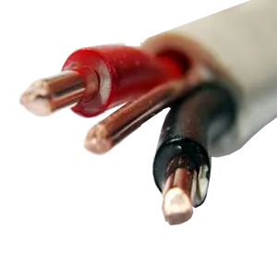
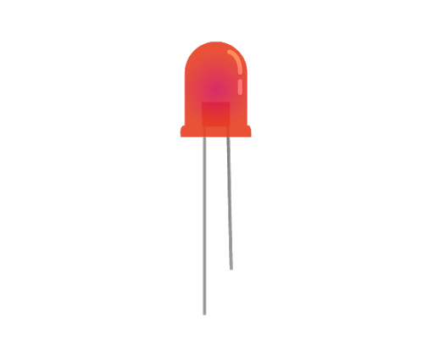
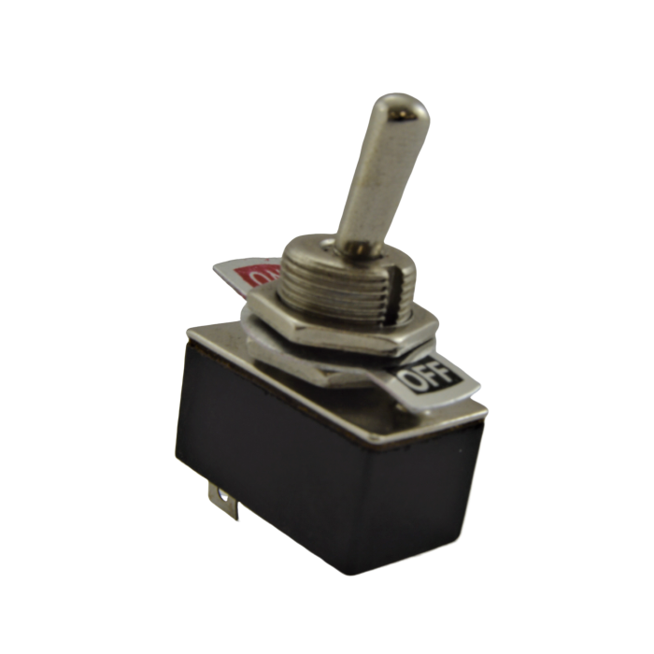
BASIC COMPONENTS OF A CIRCUIT
Power Source
Conductor
01
02
A battery or wall outlet (we’ll be using a battery)
The wires that carry the current
Load
Switch
What will be powered (LED, buzzer, etc)
04
03
Connects the circuit so electricity can flow
Notes:
mark

Slide 6
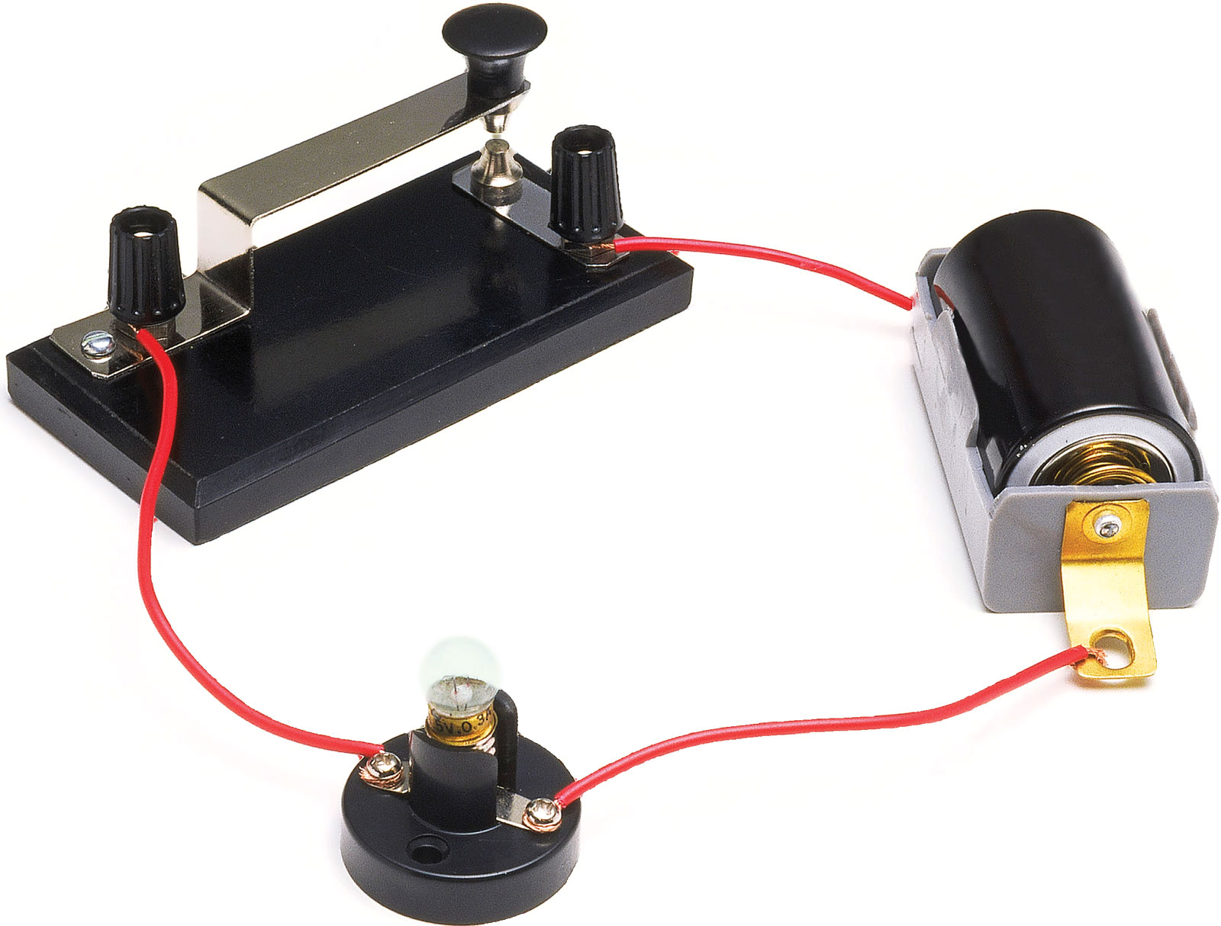
BASIC COMPONENTS OF A CIRCUIT
Voltage Source
Switch
Resistance
Conductor -- carries current
Notes:
maya

Slide 7
01
Parallel Circuits
Notes:
maya

Slide 8
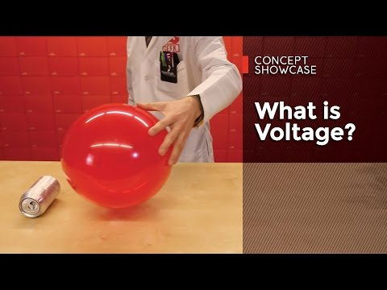
Voltage -- More in Depth
Notes:
mark

Slide 9
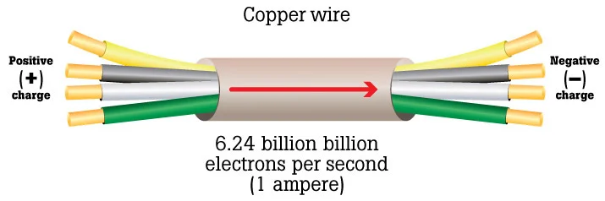
So what’s current?
Rate at which the electrons are able to flow through
How much voltage is actually able to get through as a function of resistance
Notes:
mark

Slide 10
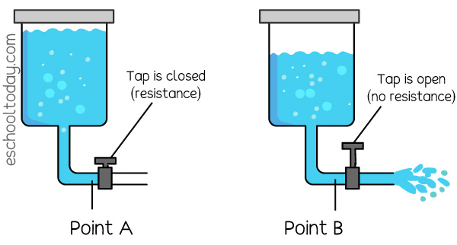
More analogies:
Usually tap is partially closed: resistance
The force of the water trying to go down: voltage
How much water that’s actually coming out: current
Notes:
maya

Slide 11
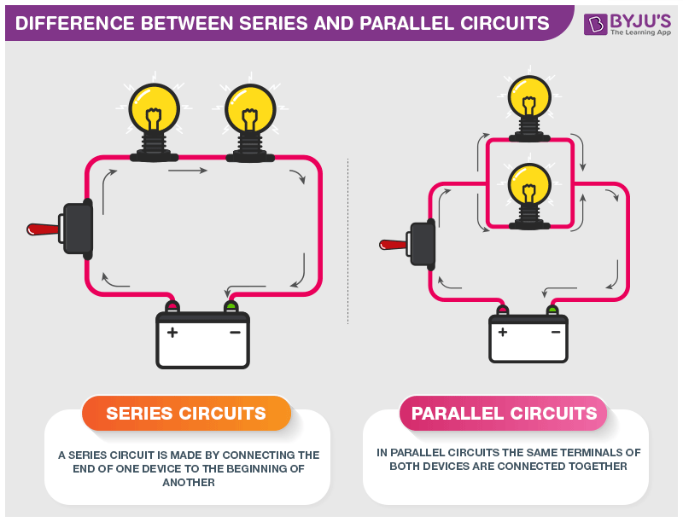
Series Circuits
A series circuit is made by connecting the end of one load component to the beginning of another.
In series circuits, the current across all of the components are the same but the voltage is split between them. Thinking about the water analogy if the circuit was a pipe all of the water would go through both components, but there are two components resisting the flow of water.
For example, if the battery is 12 volts and 2 amps each light bulb is getting 12 volts and 1 amps.
Notes:
maya

Slide 12
Parallel Circuits
Parallel circuits are wired so that the same terminal of all of the load components are connected together.
In a parallel circuit, the voltage across all of the components are the same but the current is split between components. If the circuit was a pipe the water would split causing half the water will go one way and half will go the other way.
For example, if the battery is 12 volts and 2 amps each light bulb is getting 6 volts and 2 amps.
Notes:
mark

Slide 13
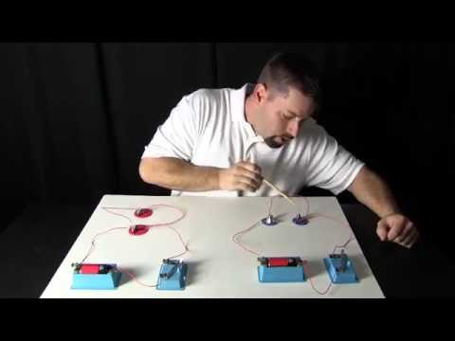
Notes:
mark

Slide 14
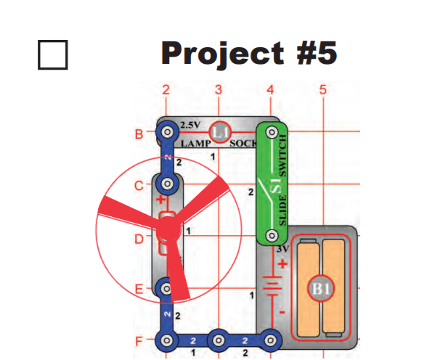
Lamp + Fan in Series
What do you observe?
Notes:
maya

Slide 15
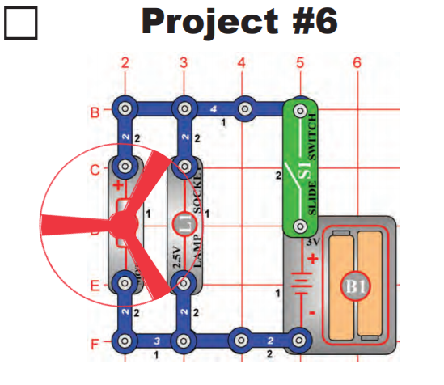
Lamp + Fan in Parallel
What do you observe?
Notes:
mark

Slide 16
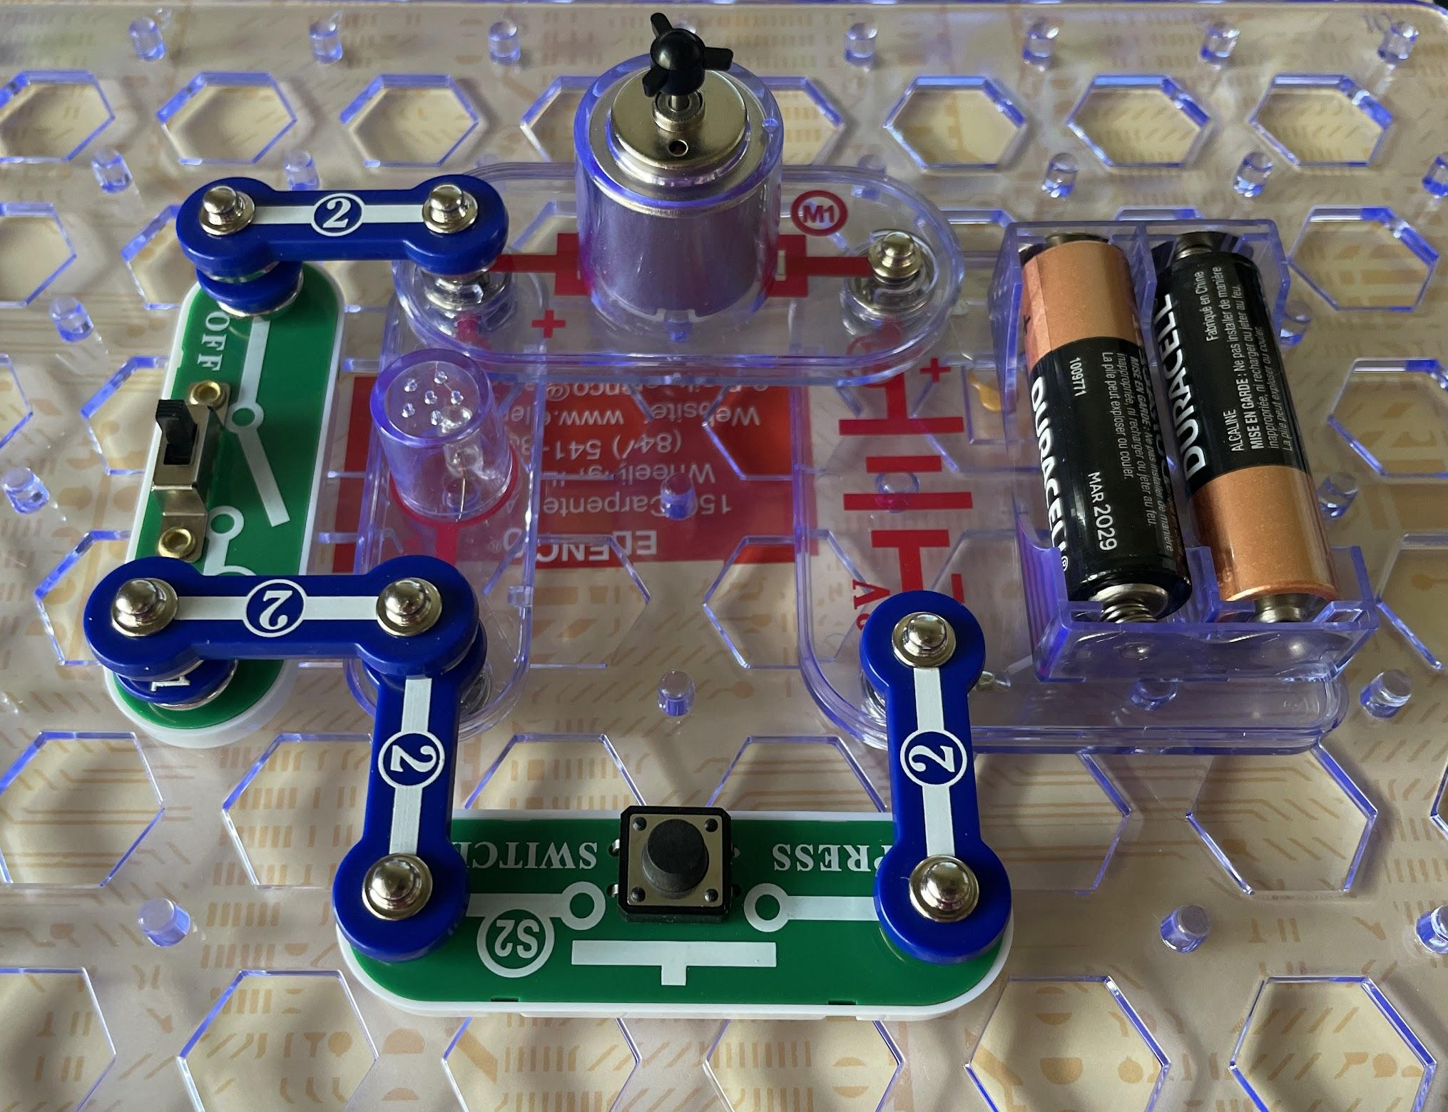
Slower Fan
What do you observe when the switch is on vs off and why do you think that happens?
Notes:
max

